Slide 1
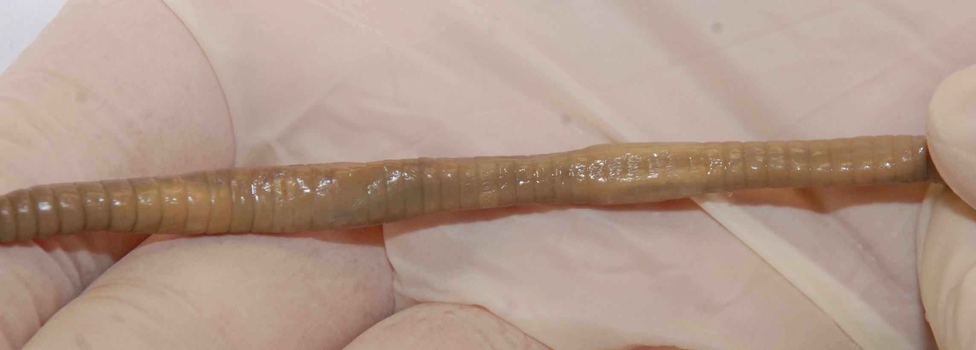
Dissection 101:
Earthworm Quiz
A
#3. What is the function of this structure?
#2. Name the structure indicated.
B
#1. Which earthworm above is displaying the ventral surface? Earthworm: A B
Click

Slide 2
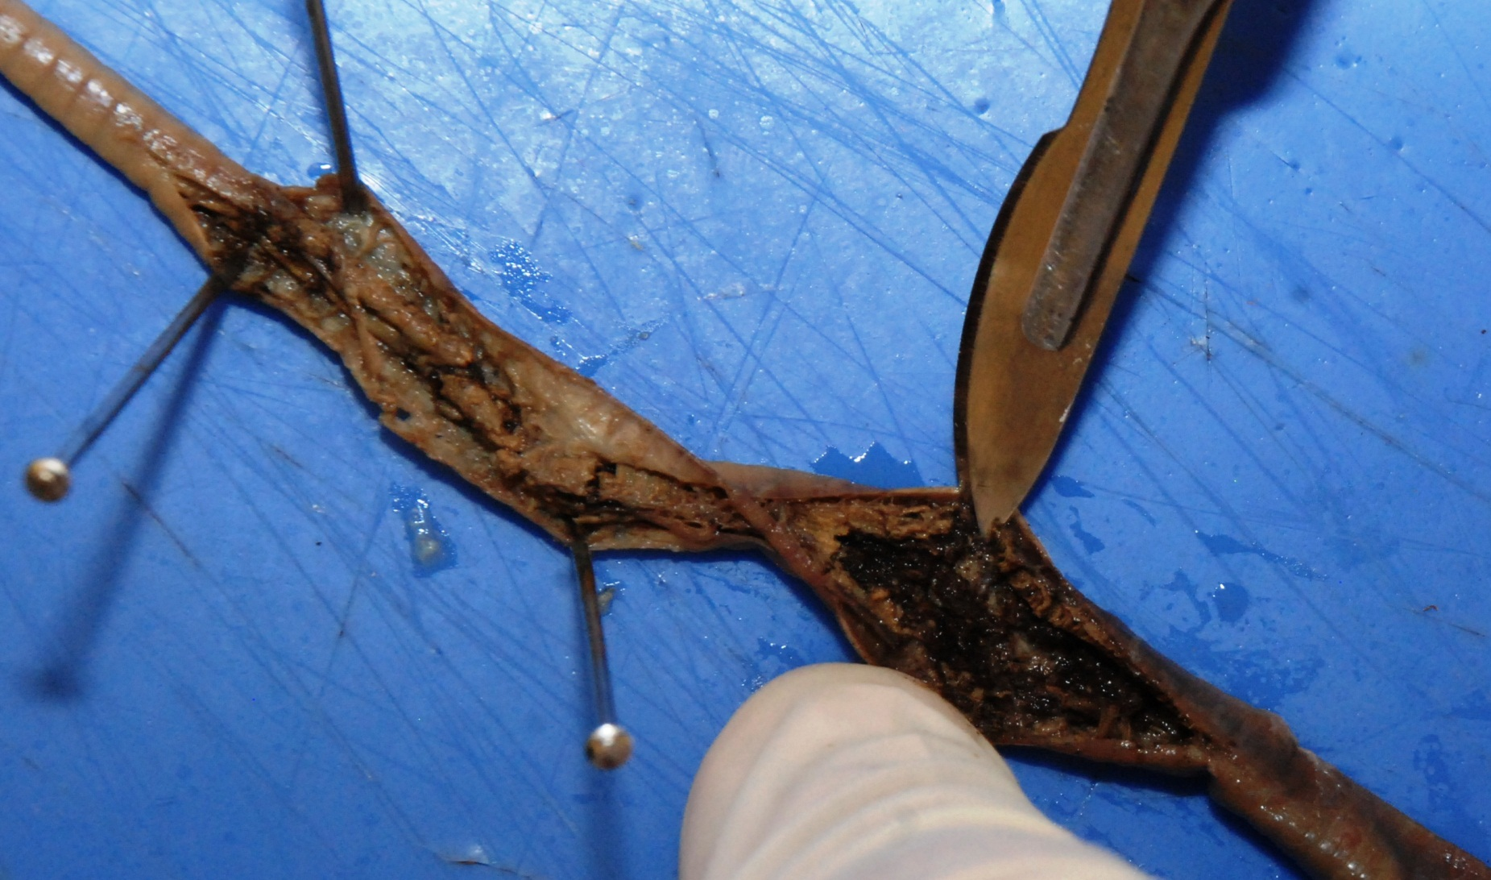
Dissection 101:
Earthworm Quiz
#4. What is the dark, black material shown above?_______
Click

Slide 3
Dissection 101:
Earthworm Quiz
#5. Name the structure indicated.
#6. What type of circulatory system does
the earthworm have?
Open system B. Closed system
Click

Slide 4
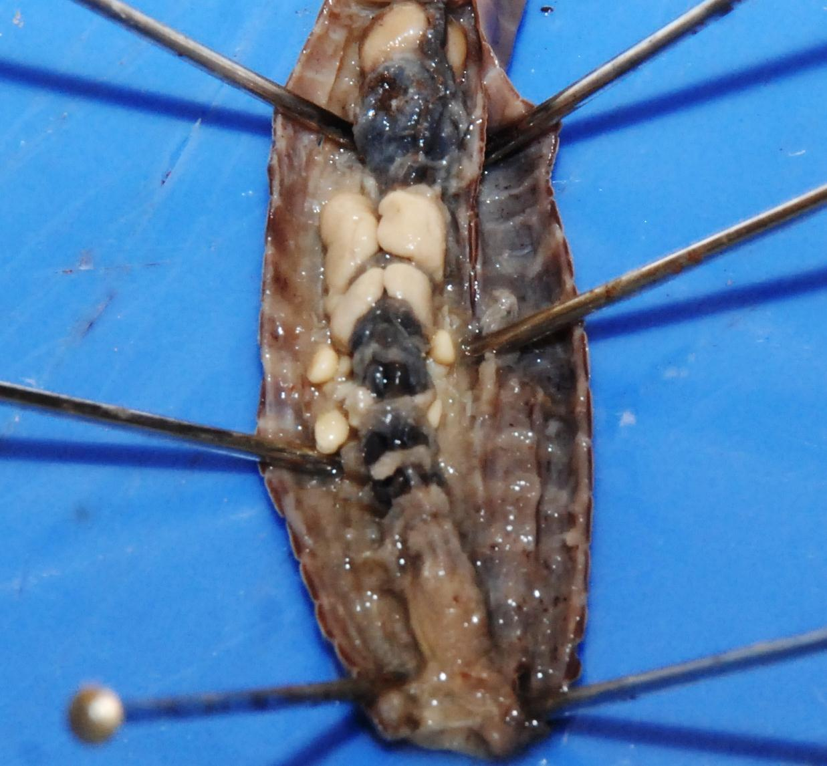
Dissection 101:
Earthworm Quiz
#8. What is the function of this structure?
#7. Name the structure indicated.
Click

Slide 5
Dissection 101:
Earthworm Quiz
#11. Gender – looking at the earthworm below,
which of the following is correct?
A. Female B. Male C. Both
#10. What is the function of this structure?
#9. Name the structure indicated.
Click

Slide 6
Dissection 101:
Earthworm Quiz
#13. What is the function of this structure?
#12. Name the structure indicated.
Click

Slide 7
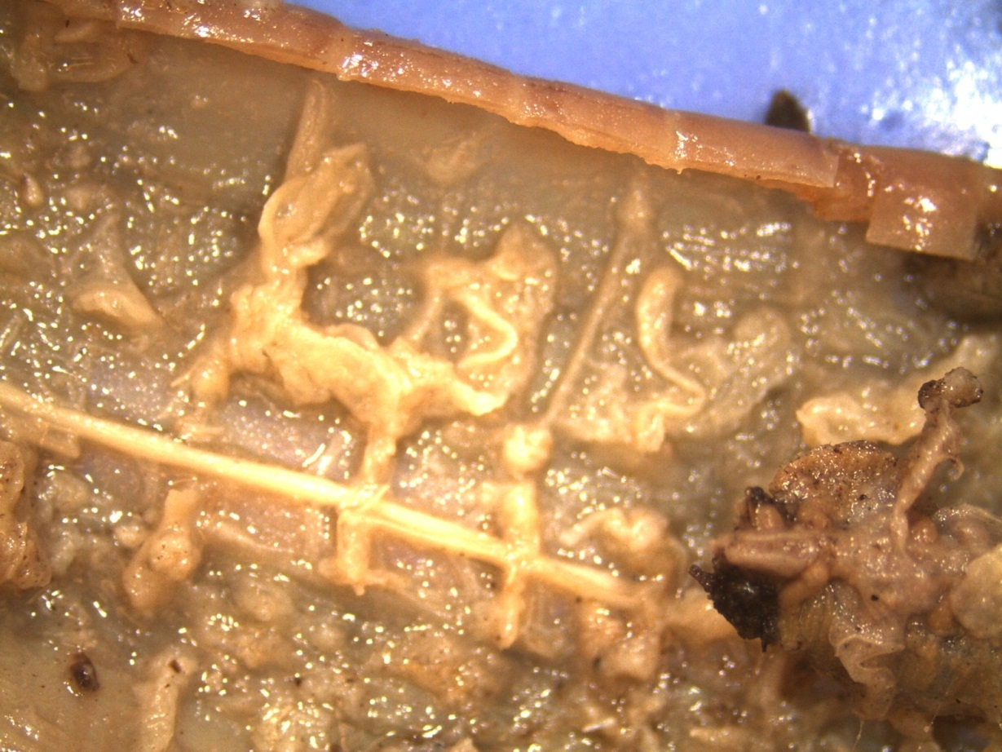
Dissection 101:
Earthworm Quiz
#14. Which system is this structure associated with?
A. Digestive B. Nervous C. Reproductive D. Circulatory
Click

Slide 8
Dissection 101:
Earthworm Quiz
#15. Describe the movement of the earthworm
using the following terms.
(setae, circular muscles, longitudinal muscles, segments) ____________________________________________________________________________________________________________________________________________________________________________________________________________________________________________________________________
Click

Slide 9
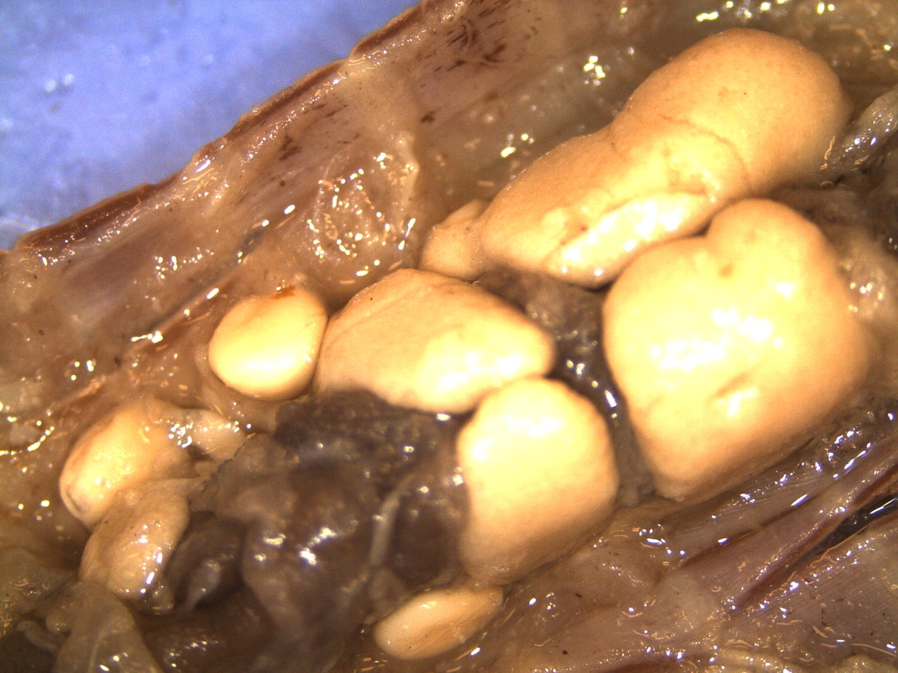
Dissection 101:
Earthworm Quiz
Produced by Dakota State University
and South Dakota Public Broadcasting

