Slide 1
Dissection 101:
Reasons to Use the Dissection Video and
Accompanying PowerPoint Presentation
Reduce the number of specimens used by a class
Increase the quality of the dissection for the students
Review opportunity, increasing the learning experience for the students
Student unable to dissect due to pregnancy or hypersensitivity to the preservatives
Student chooses not to dissect due to ethical/moral reasons
Click

Slide 2
Dissection 101:
As an educator you are responsible for the implementation of the dissection activity described in the video and PowerPoint. You must have safety procedures and rules established for your classroom and make sure all of the students follow the rules to ensure a safe environment. South Dakota Public Broadcasting and Dakota State University cannot in any way be responsible or liable for any injury as a result of performing the described dissection. Complete the dissection if you feel it is appropriate and safe for your individual class.
Have fun and stay safe!
Safety Considerations
Age appropriate activity for the children in your care
Material Safety Data Sheet (MSDS) available for accident reference
Poison control number/phone readily available
Latex free gloves, eye protection and apron/lab coat
Eyewash station, shower and sink
Sharp instruments (cut away from self and others)
Sharps and specimen(s) disposal
Encourage students to report all accidents
Basic science laboratory rules (strictly enforced)
Click

Slide 3
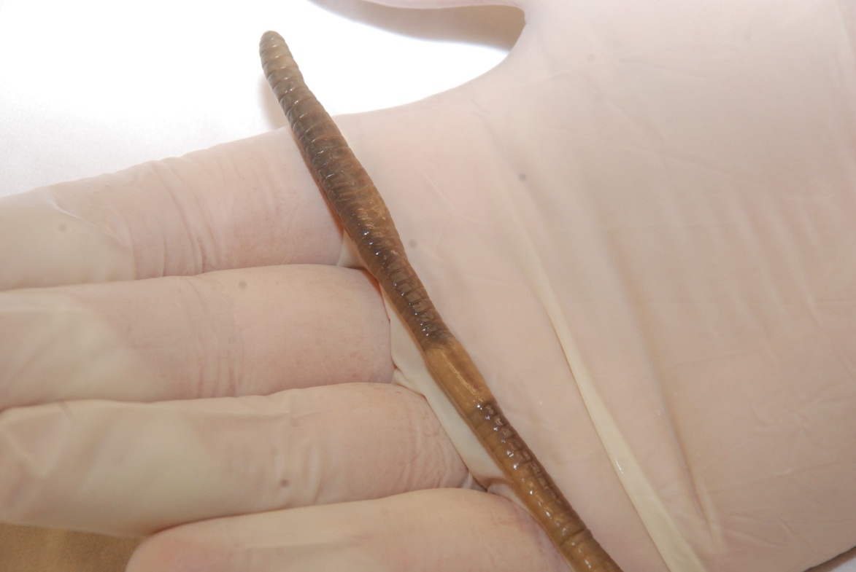
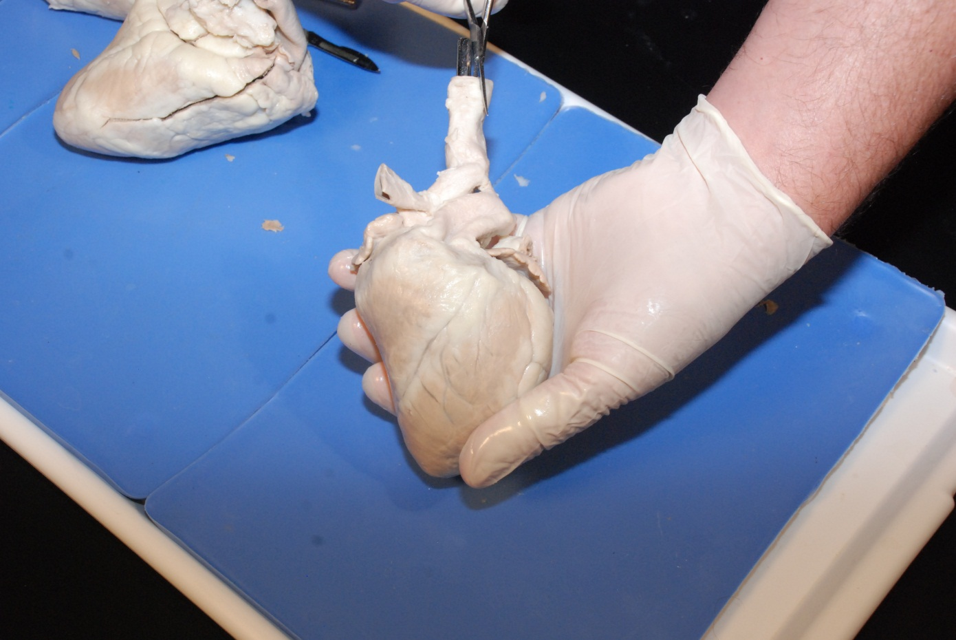
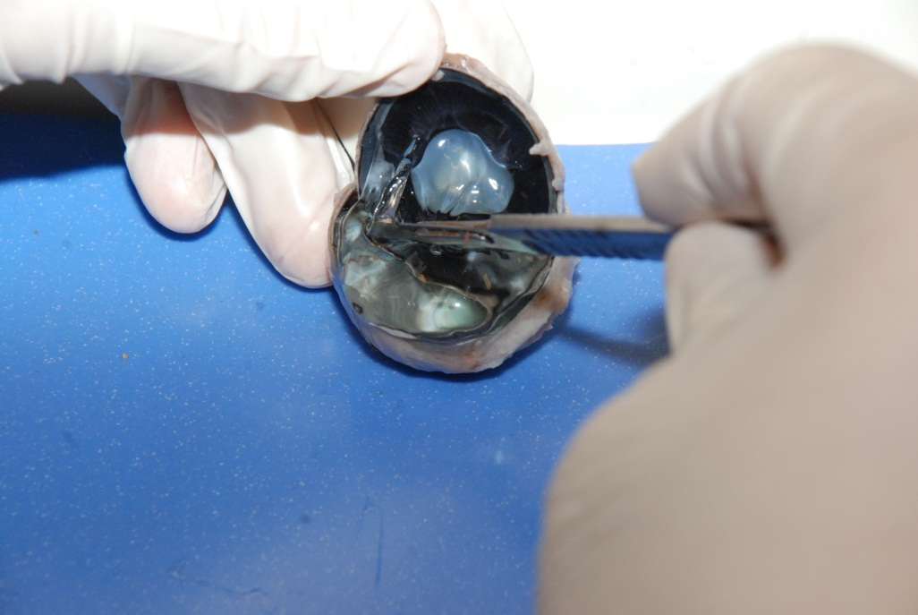
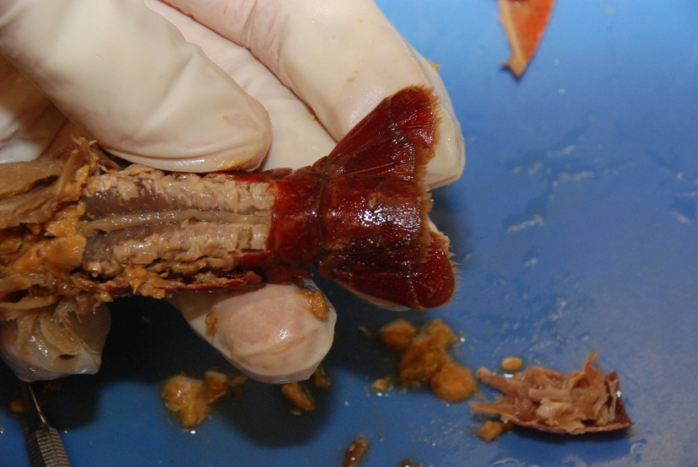
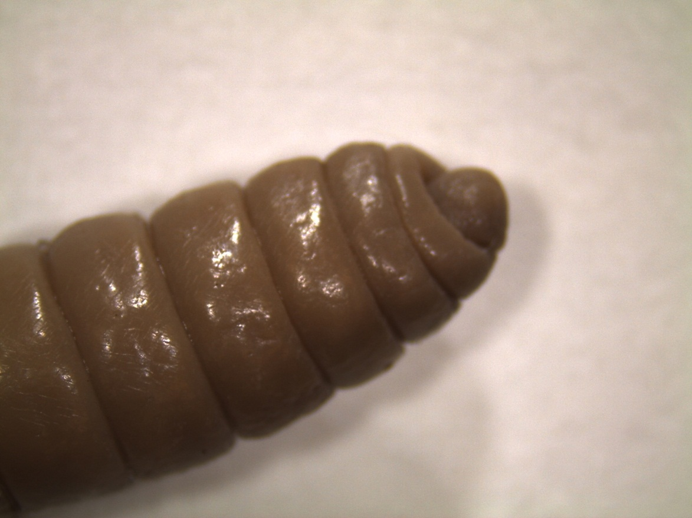
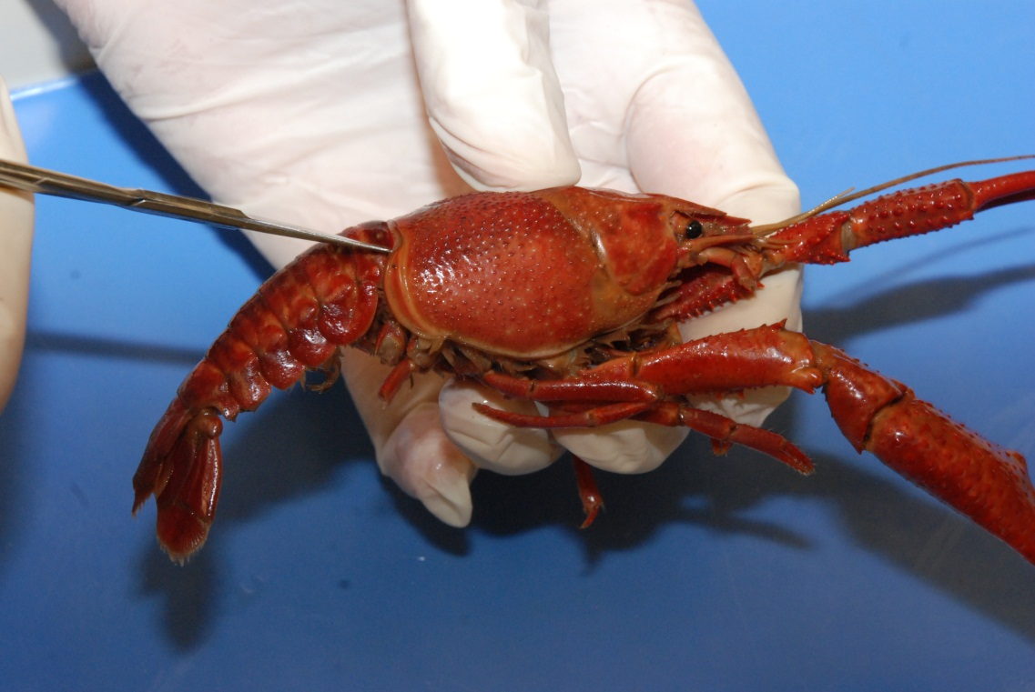
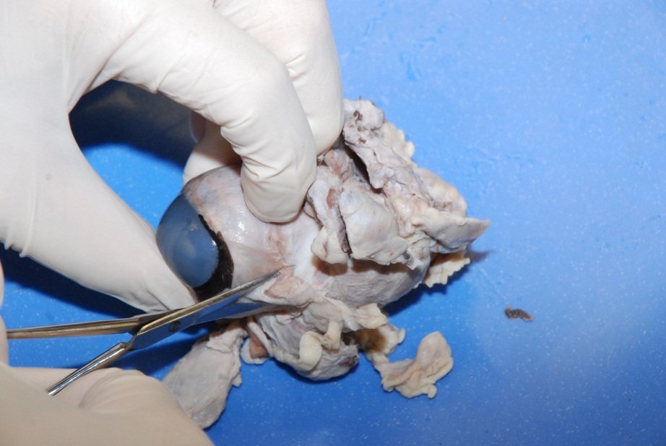
Dissection 101:
Earthworm
Click

Slide 4
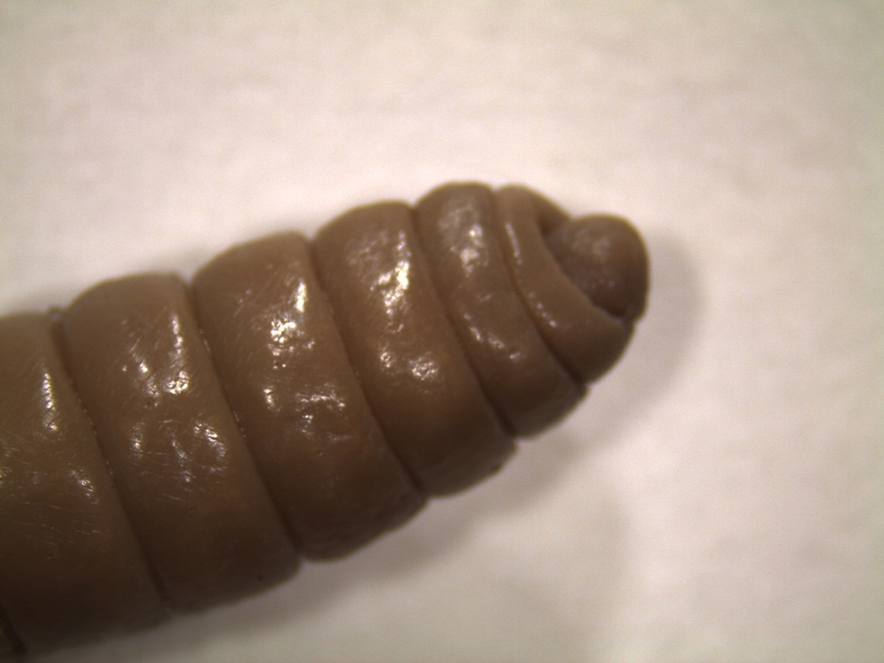
Exterior of the Earthworm
Orientation
Anterior
(closer to the clitellum)
Mouth: deposit feeder, soil into mouth, absorption of nutrients with digestive system, returns soil and unused organic material to ground
Clitellum
(Reproductive structure, produces the slime tube/cocoon which accepts the sperm and eggs, external fertilization in the cocoon)
Posterior
(greater distance from the clitellum)
Click

Slide 5
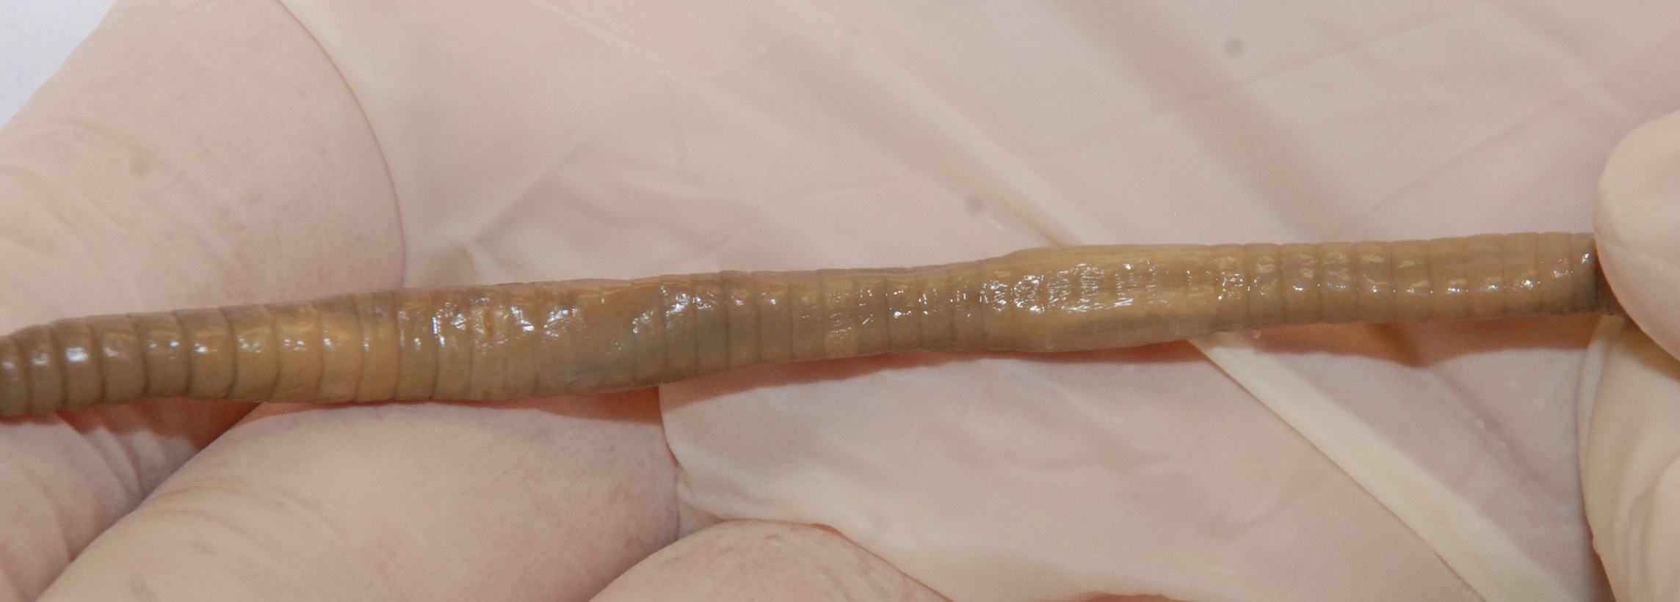
Exterior of the Earthworm
Orientation
Ventral
(Bottom side, lighter color, setae which feel like sandpaper/bristle)
Clitellum
Noticeable segments
Dorsal
(Top side, darker color)
Click

Slide 6
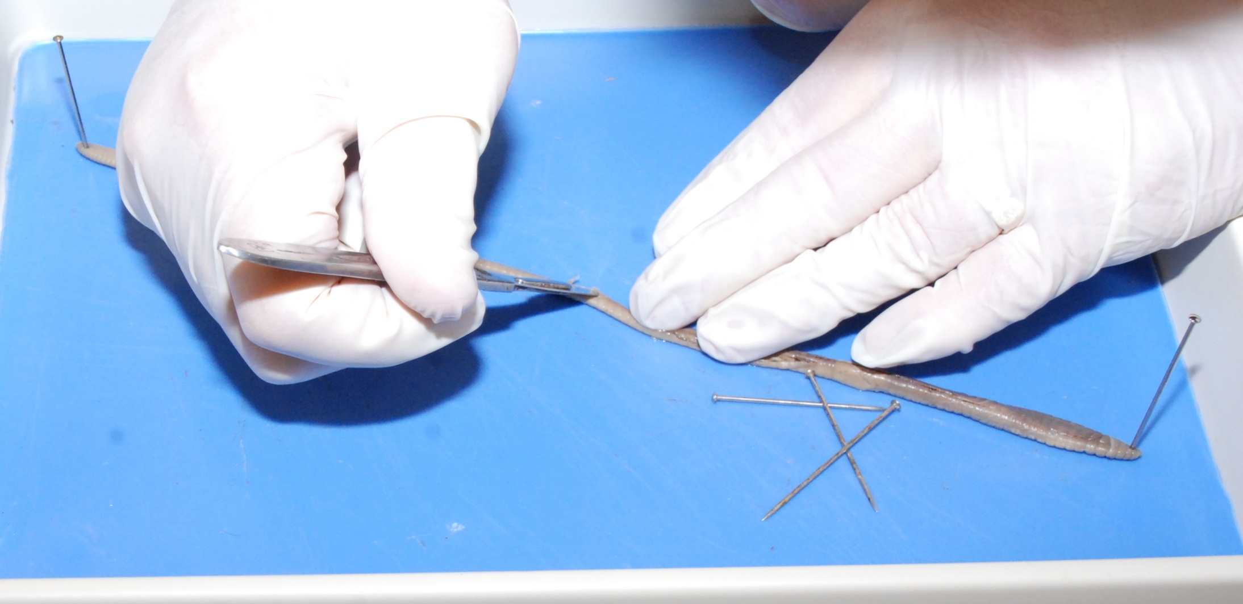
Dissection 101:
Earthworm
Getting Started
Place the ventral surface down (usually lighter in color and has bristle like setae)
Pin both the anterior and posterior ends – pull taut
Click

Slide 7
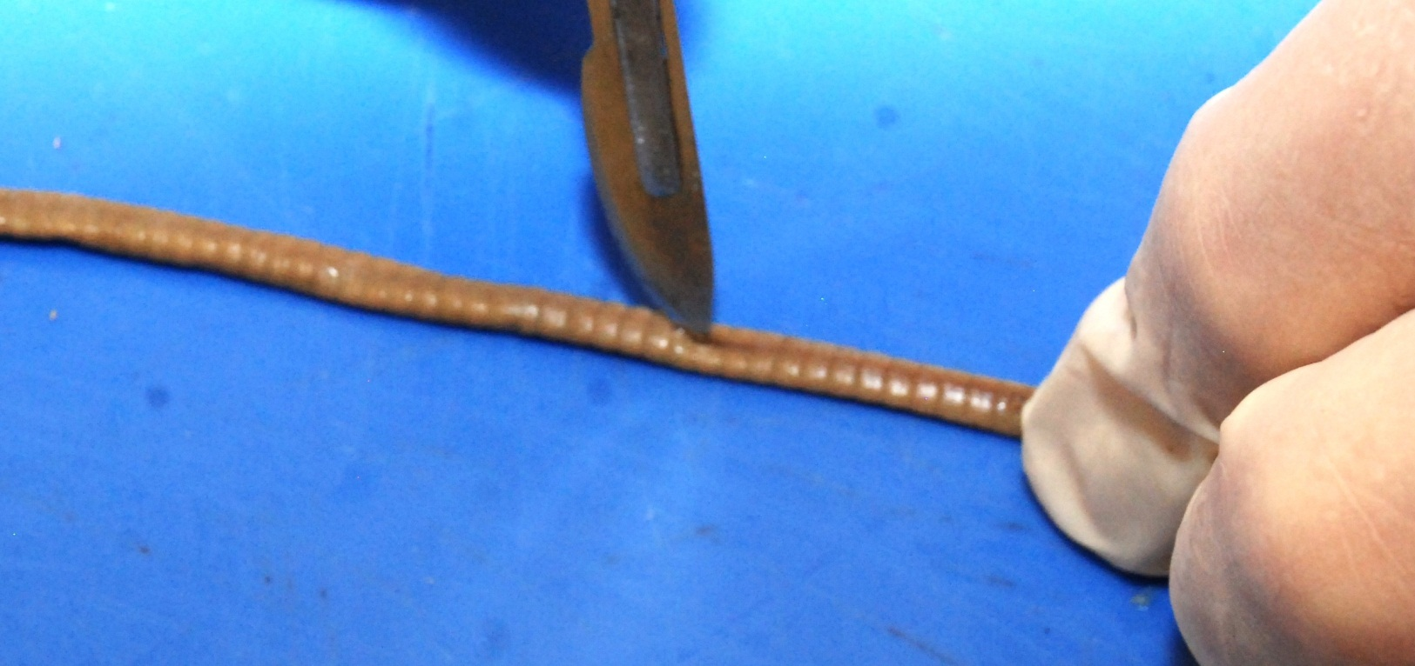
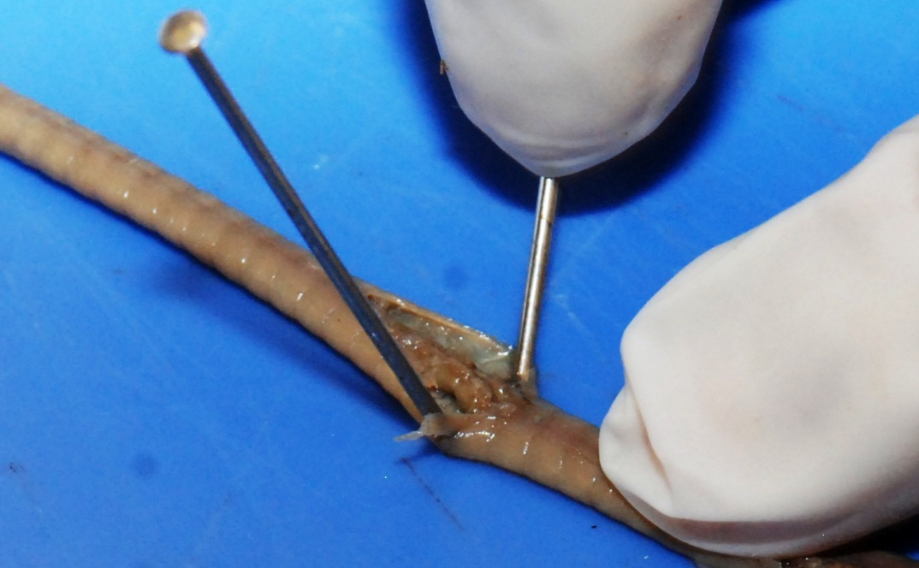
Dissection 101:
Earthworm
Getting Started
Student Cuts:
YouTube
SDPB
Start the dissection in the middle of the specimen to reduce damage to anterior end of the earthworm where most of the specialized structures are located
Thin outer layer, cut slowly and shallow
Continue cutting both anteriorly and posteriorly, always cut away from yourself
Secure the specimen with pins as you cut
Click

Slide 8
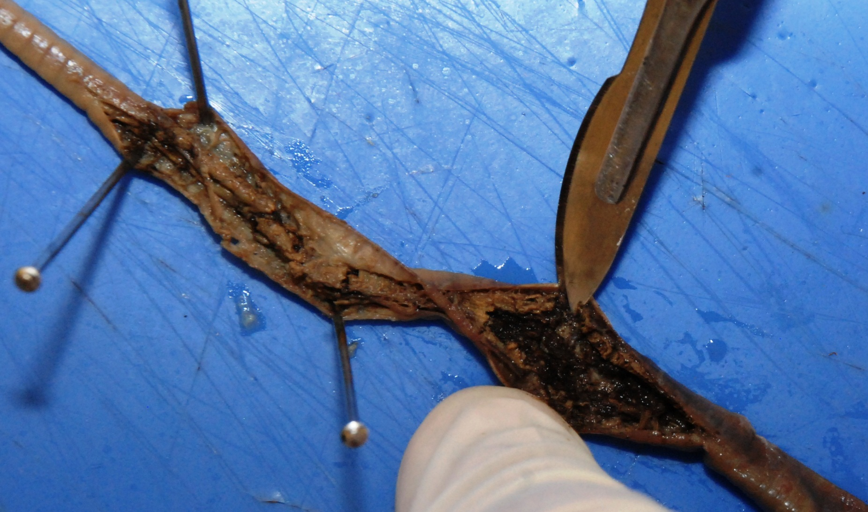
Dissection 101:
Earthworm
Do not cut too deep - cut intestine shown here, dark soil is visible
Click

Slide 9
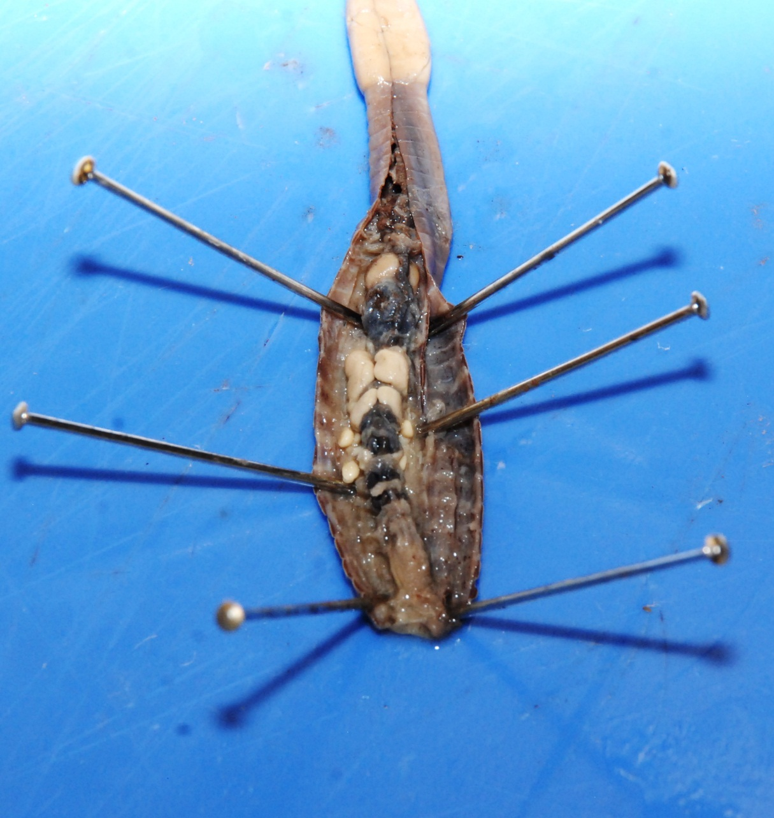
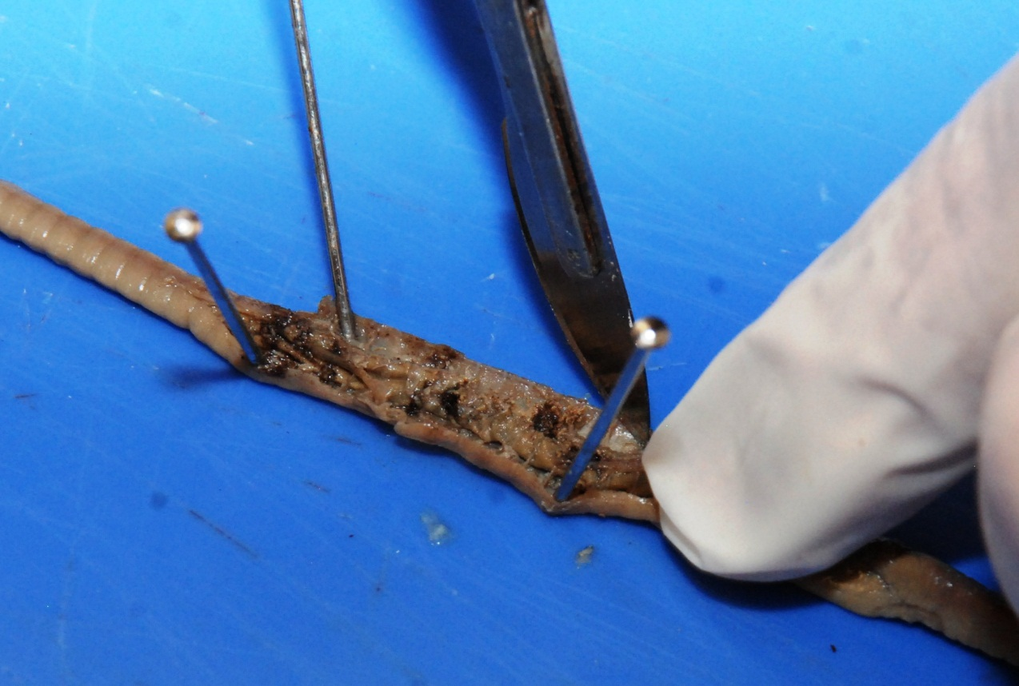
Dissection 101:
Earthworm
Continue dissecting specimen, securing with pins as you cut
Student Cuts:
YouTube
SDPB
Anterior end
Click

Slide 10
Identify the following Structures
Circulatory System (closed)
Dorsal blood vessel (aorta): pumping vessel, darker in color
Aortic arches: Carry blood from the dorsal blood vessel toward the ventral side, helps maintain pressure, dark in color, labeled heart in many books
Click

Slide 11
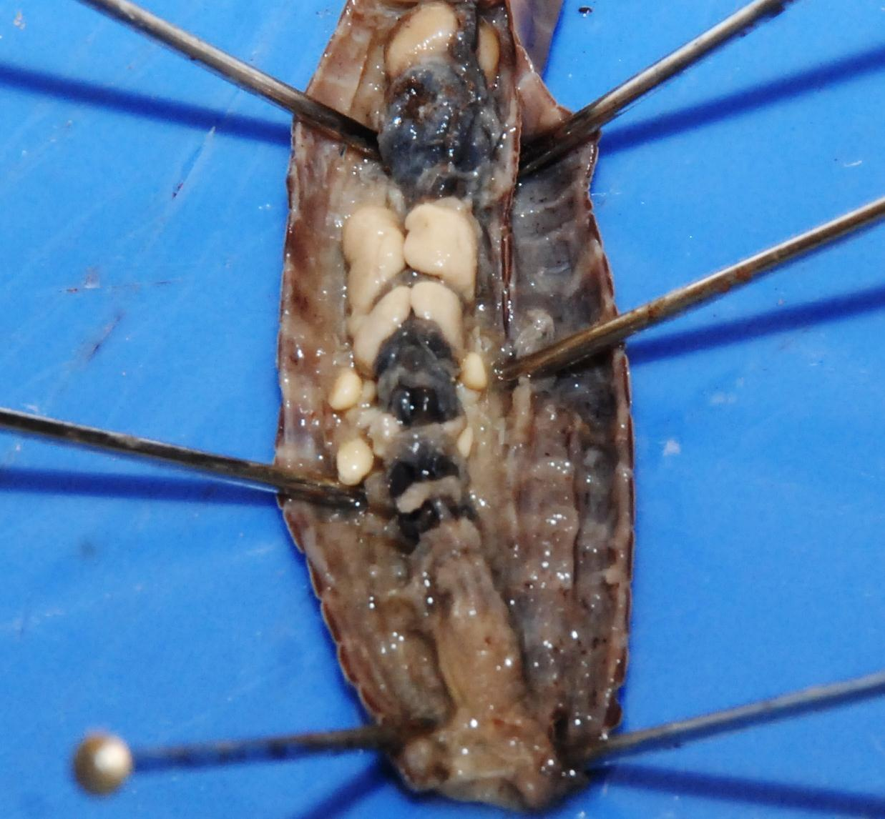
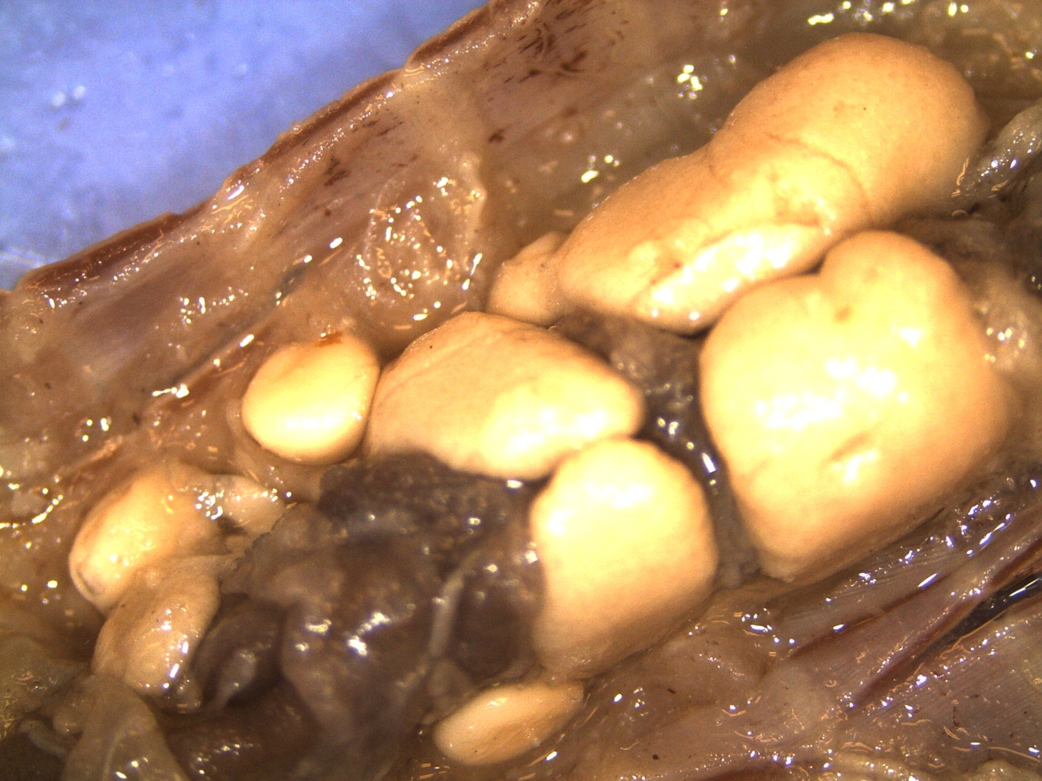
Identify the following Structures
Reproductive System
Seminal vesicles: Store sperm produced within the worm (globular)
Seminal receptacles
Seminal receptacles: Store sperm received from another worm (spherical)
Seminal vesicles
Note: Monoecious with female and male gametes, testes and ovaries are identified in books, but are difficult to locate
Anterior end
Click

Slide 12
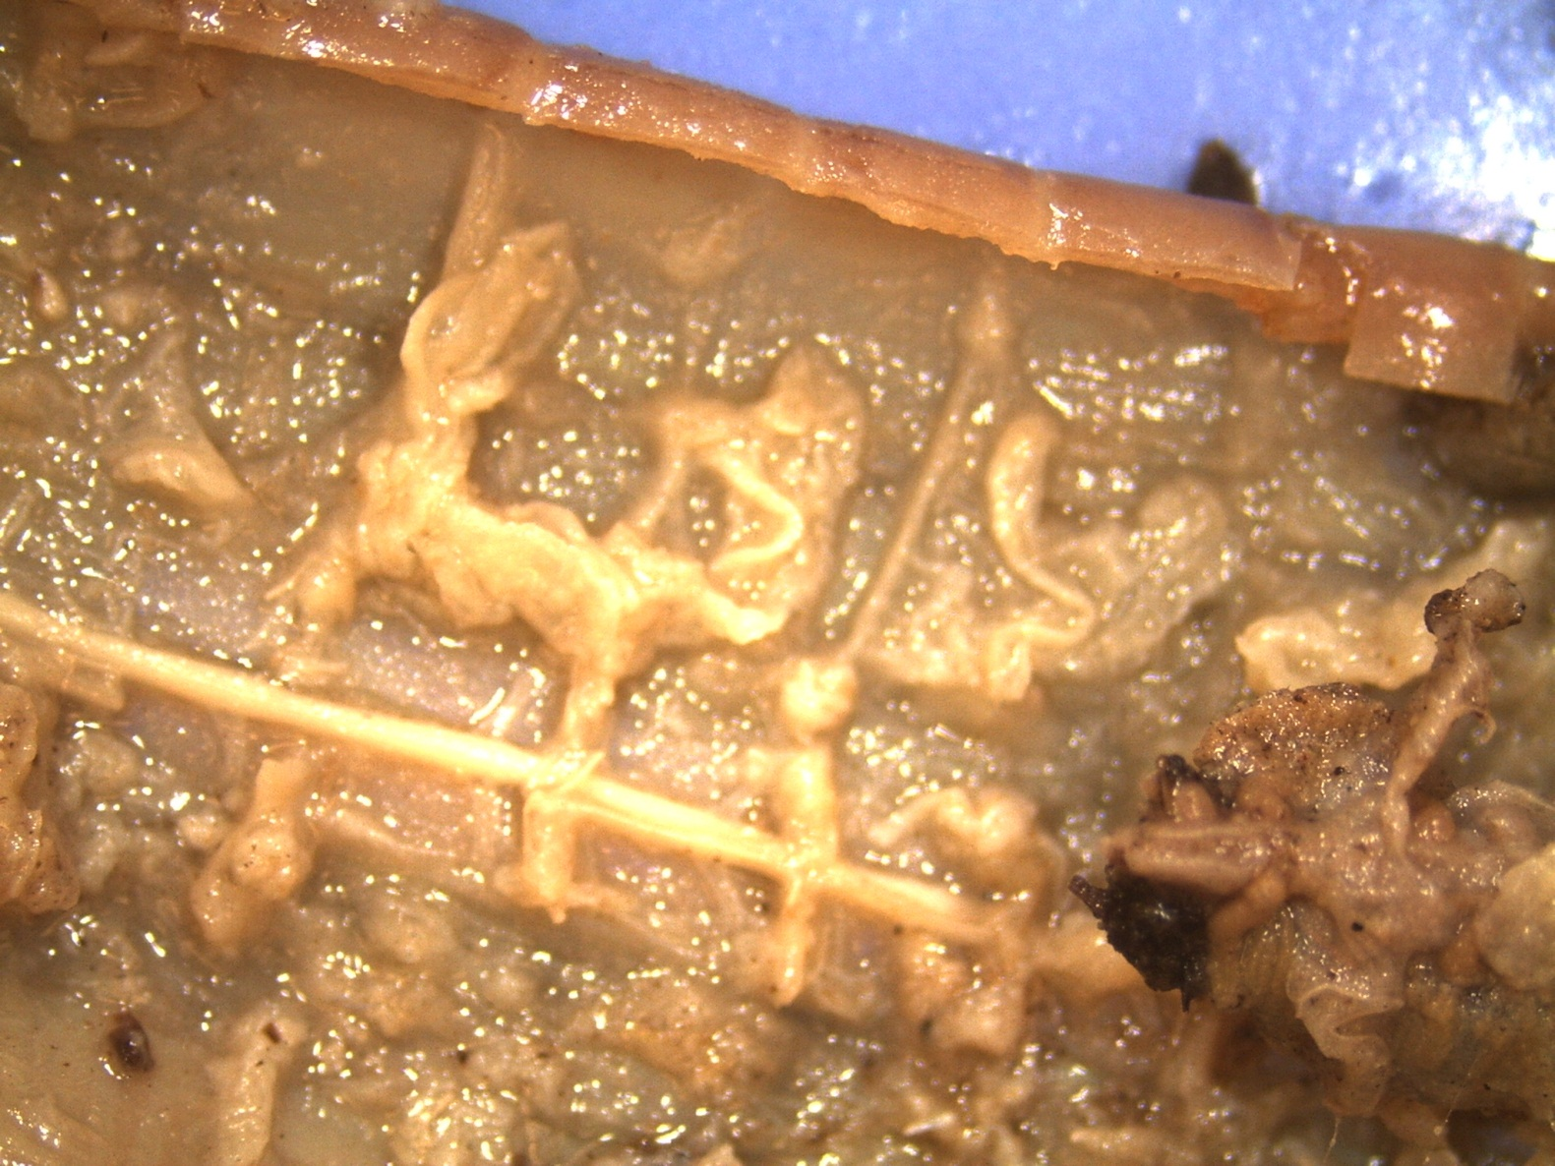
Identify the following Structures
Nervous System
Nerve tissue extending
into segments
Remove/scrape a section of the intestine to expose the nerve cord
Intestine
Nerve cord, ventral surface
Click

Slide 13
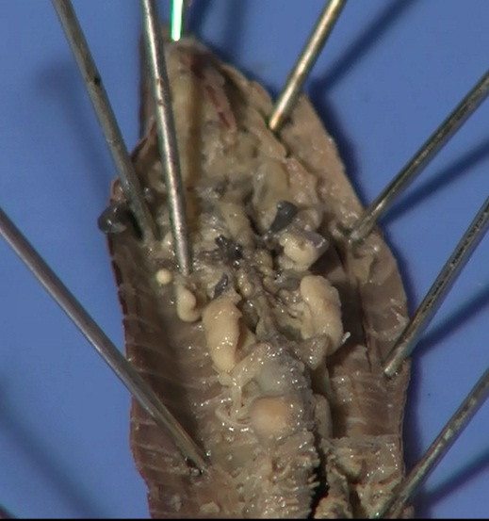
Identify the following Structures
Digestive System
Pharynx: Swallows food (soil), muscular tube, connects mouth to esophagus
Esophagus: Aortic arches and seminal receptacles removed
(Final cut, wait until PowerPoint is complete)
Esophagus: Movement
of food (soil) toward crop, lies below aortic arches
Dorsal blood vessel
Mouth
Click

Slide 14
Identify the following Structures
Digestive System
Pharynx
Crop: Food storage, similar to the stomach of a vertebrate, thin walled
Mouth
Gizzard: Grinds food, thick walled, muscular
Esophagus
Click

Slide 15
Identify the following Structures
Digestive System
Pharynx
Crop
Intestine: Food digestion and nutrient absorption
Student Cuts:
YouTube
SDPB
Gizzard
Mouth
Esophagus
Click

Slide 16
Dissection 101:
Earthworm
Produced by Dakota State University
and South Dakota Public Broadcasting

